Slide 1

Chapter 13 Part 3
Business Intelligence and Data Warehouses
The slides in this presentation have been adapted from slides provided with the textbook, Database Systems: Design, Implementation, and Management,
12E, Cornel and Morris, Copyright © 2017 Cengage Learning.

Slide 2
Learning Objectives
About data analytics, data mining, and predictive analytics
About online analytical processing (OLAP)
How SQL extensions are used to support OLAP-type data manipulations
Copyright © 2017 Cengage Learning
2

Slide 3
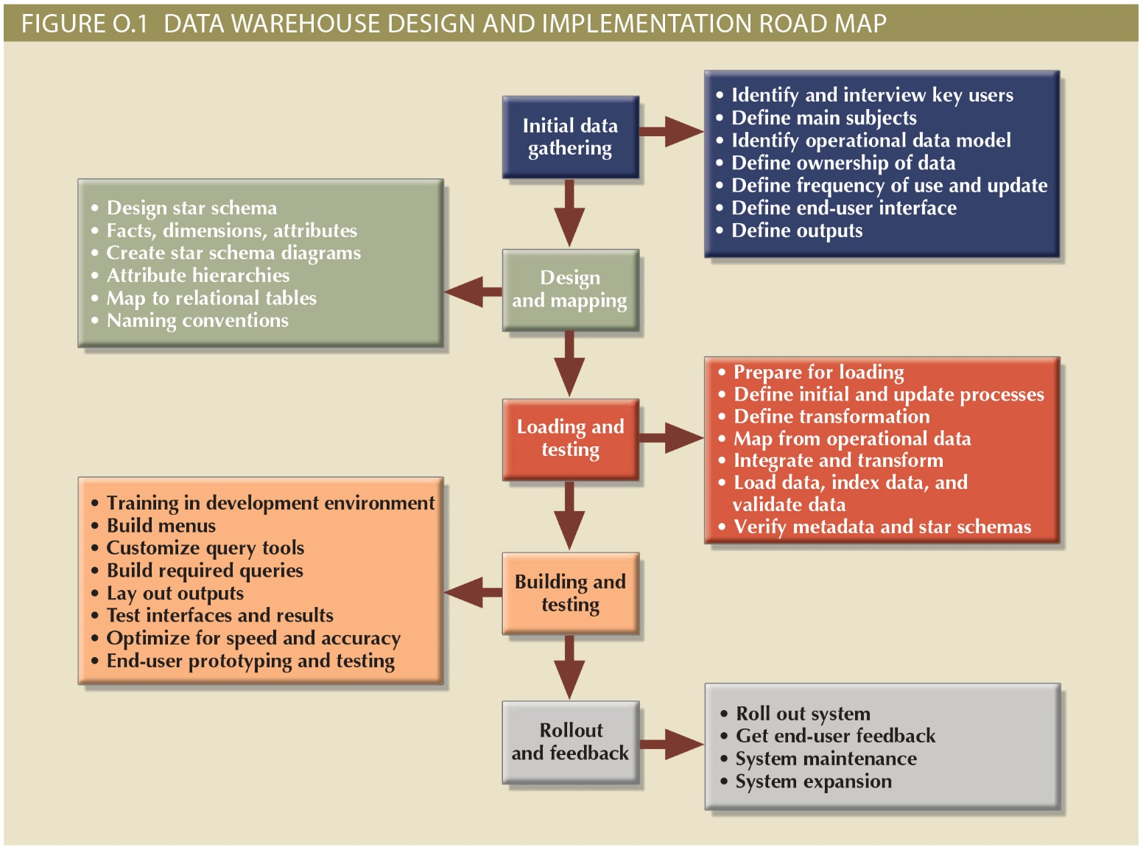
Copyright © 2017 Cengage Learning
3

Slide 4
Data Analytics
Encompasses a wide range of mathematical, statistical, and modeling techniques to extract knowledge from data
Subset of BI functionality
Classification of tools
Explanatory analytics: Focuses on discovering and explaining data characteristics and relationships based on existing data
Predictive analytics: Focuses on predicting future outcomes with a high degree of accuracy
Copyright © 2017 Cengage Learning
4

Slide 5
Data Mining
Analyzing massive amounts of data to:
Uncover hidden trends, patterns, and relationships
Form computer models to stimulate and explain the findings
Use the models to support business decision making
Run in two modes
Guided
Automated
Copyright © 2017 Cengage Learning
5

Slide 6
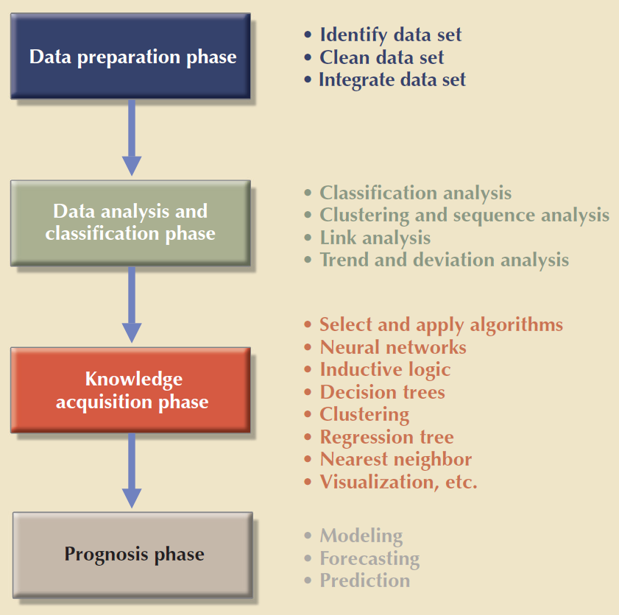
Copyright © 2017 Cengage Learning
6

Slide 7
Predictive Analytics
Employs mathematical and statistical algorithms, neural networks, artificial intelligence, and other advanced modeling tools
Creates actionable predictive models based on available data
Next logical step after data mining
Adds value to an organization
Helps optimize the existing processes
Identify hidden problems
Anticipate future problems or opportunities
Copyright © 2017 Cengage Learning
7

Slide 8
Online Analytical Processing
Advanced data analysis environment that supports decision making, business modeling, and operations research
Characteristics
Multidimensional data analysis techniques
Advanced database support
Easy-to-use end-user interfaces
Copyright © 2017 Cengage Learning
8

Slide 9
Multidimensional Data Analysis Techniques
Data are processed and viewed as part of a multidimensional structure
Augmenting functions
data presentation functions
data aggregation, consolidation, and classification functions
computational functions
Copyright © 2017 Cengage Learning
9

Slide 10
Easy-to-Use End-User Interface
Proper implementation leads to simple navigation and accelerated decision making or data analysis
Advanced OLAP features are more useful when access is kept simple
Many interface features are borrowed from previous generations of data analysis tools
Copyright © 2017 Cengage Learning
10

Slide 11
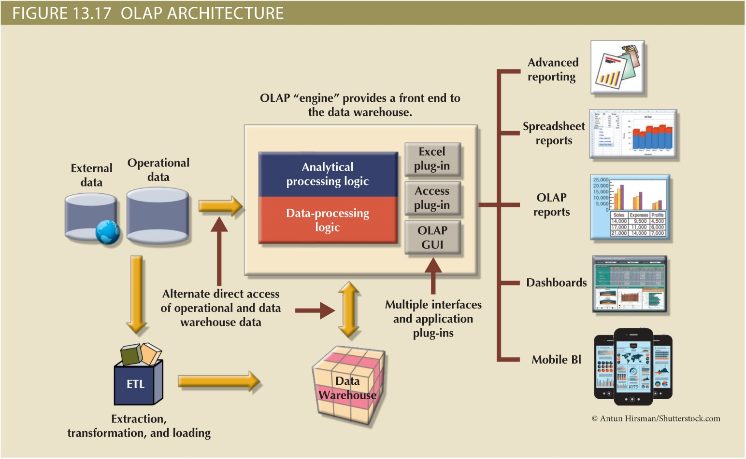
Figure 13.17 - OLAP Architecture
Copyright © 2017 Cengage Learning
11

Slide 12
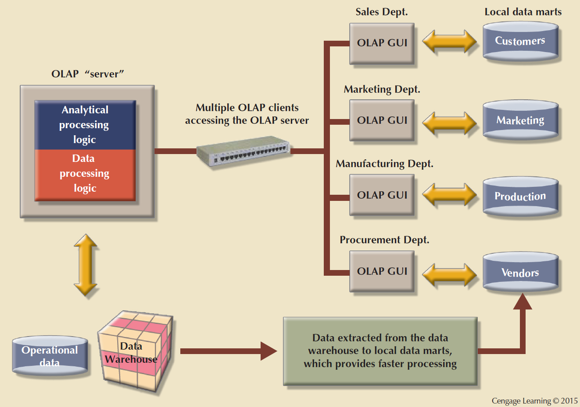
Copyright © 2017 Cengage Learning
12

Slide 13
Relational Online Analytical Processing (ROLAP)
Provides OLAP functionality using relational databases and familiar relational tools to store and analyze multidimensional data
Extensions added to traditional RDBMS technology
Multidimensional data schema support within the RDBMS
Data access language and query performance optimized for multidimensional data
Support for very large databases (VLDBs)
Copyright © 2017 Cengage Learning
13

Slide 14
Multidimensional Online Analytical Processing (MOLAP)
Extends OLAP functionality to multidimensional database management systems (MDBMSs)
MDBMS: Uses proprietary techniques store data in matrix-like n-dimensional arrays
End users visualize stored data as a 3D data cube
Grow to n dimensions, becoming hypercubes
Held in memory in a cube cache to speed access
Sparsity: Measures the density of the data held in the data cube
Copyright © 2017 Cengage Learning
14

Slide 15
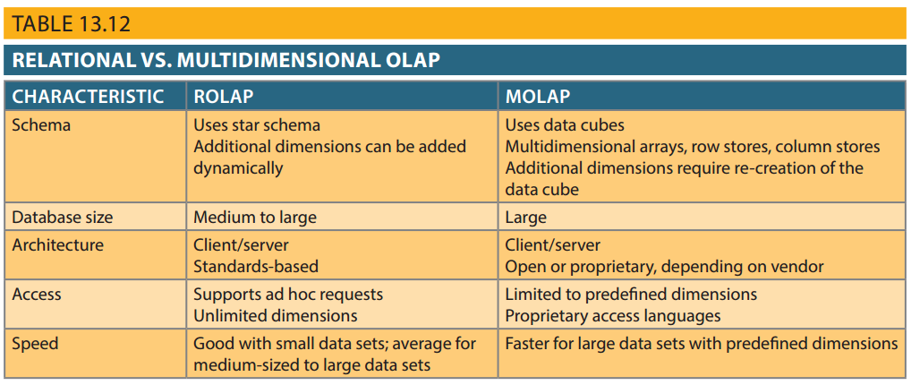
Table 13.12 - Relational vs. Multidimensional OLAP
Copyright © 2017 Cengage Learning
15

Slide 16
SQL Extensions for OLAP
The ROLLUP extension
Used with GROUP BY clause to generate aggregates by different dimensions
Enables subtotal for each column listed except for the last one, which gets a grand total
Order of column list important
The CUBE extension
Used with GROUP BY clause to generate aggregates by the listed columns
Includes the last column
Copyright © 2017 Cengage Learning
16

Slide 17
SQL Extensions Rollup
/* ROLLUP EXAMPLE */
SELECT V_CODE, P_CODE,
SUM(SALE_UNITS*SALE_PRICE) AS TOTSALES
FROM DWDAYSALESFACT NATURAL JOIN
DWPRODUCT NATURAL JOIN DWVENDOR
GROUP BY ROLLUP (V_CODE, P_CODE)
ORDER BY V_CODE, P_CODE;
Copyright © 2017 Cengage Learning
17

Slide 18
SQL Extensions Cube
/* CUBE EXAMPLE */
SELECT TM_MONTH, P_CODE, SUM(SALE_UNITS*SALE_PRICE) AS TOTSALES
FROM DWDAYSALESFACT NATURAL JOIN DWPRODUCT NATURAL JOIN DWTIME
GROUP BY CUBE (TM_MONTH, P_CODE)
ORDER BY TM_MONTH, P_CODE;
Copyright © 2017 Cengage Learning
18

Slide 19
Materialized View
/* CREATE AMATERIALIZED VIEW TO REFRESH ON COMMIT */
/* REFRESH ON COMMIT */
CREATE MATERIALIZED VIEW SALES_MONTH_MV
BUILD IMMEDIATE
REFRESH FORCE ON COMMIT
ENABLE QUERY REWRITE
AS SELECT TM_YEAR, TM_MONTH, P_CODE,
SUM(SALE_UNITS) AS SUM_UNITS,
SUM(SALE_PRICE*SALE_UNITS) AS SUM_SALES
FROM DWTIME T, DWDAYSALESFACT S
WHERE S.TM_ID = T.TM_ID
GROUP BY TM_YEAR, TM_MONTH, P_CODE;
Copyright © 2017 Cengage Learning
19

Slide 20
Summary
Data analytics
Provides advanced data analysis tools to extract knowledge from business data
Data mining
Automates the analysis of operational data to find previously unknown data characteristics, relationships, dependencies, and trends
Predictive analytics
Uses information generated in the data-mining phase to create advanced predictive models
Copyright © 2017 Cengage Learning
20

Slide 21
Summary (cont’d.)
Online analytical processing (OLAP)
Advanced data analysis environment that supports decision making, business modeling, and operations research
SQL has been enhanced with extensions that support OLAP-type processing and data generation
Copyright © 2017 Cengage Learning
21

Slide 22
Task
Find an example of an OLAP success story by searching the Internet. Determine why they think it was successful in the case you find.
Copyright © 2017 Cengage Learning
22

